Slide 1



COURSE RECOMMENDATION SYSTEM
Rohith Challa (ZI04298)

Slide 2
INTRODUCTION & OBJECTIVE
This project is a comprehensive data processing and recommendation system for online courses. It demonstrates how to clean, analyze, and preprocess a dataset of online courses.
The main goal is to extract meaningful insights from features and build a course recommendation system based on course content.
It involves the following key tasks:
Data Cleaning and pre-processing
Data Analysis
Stemming and Vectorization
Recommendation Function

Slide 3
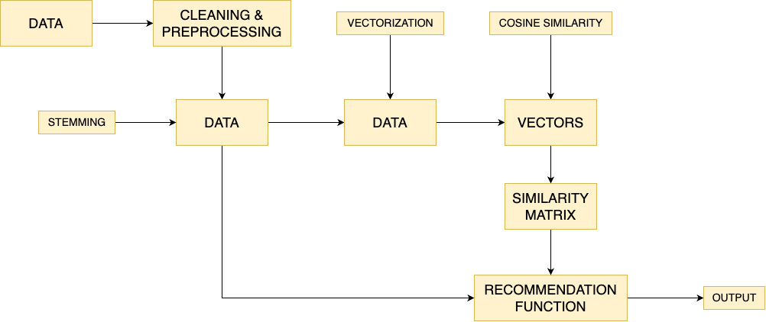
ARCHITECTURE

Slide 4
DATA
Each Row Represents
A course on Coursera
Data Size
8.72 MB
Data Shape
Before Data Cleaning - 3522 rows x 7 columns
After Data Cleaning - 3392 rows x 8 columns

Slide 5

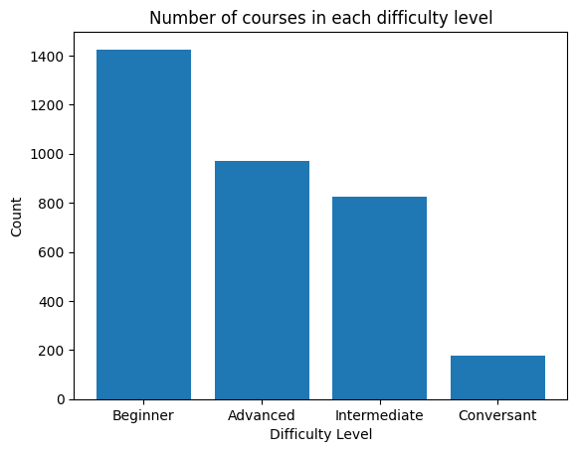
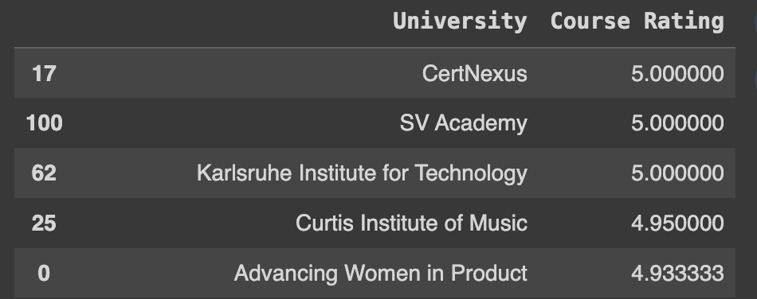
ANALYSIS AND VISUALIZATION
Universities CertNexus, SV Academy, and Karlsruhe Institute for Technology have the highest course ratings.
Universities Universidad Nacional Autnoma de Mxico, Carnegie Mellon University, and Yandex have the lowest course ratings.
Most of the courses are of beginner level and rest of them mostly being advanced and intermediate.
Courses from almost all difficulty levels have average course rating of 4.5

Slide 6
STEMMING
Made use of Porter Stemmer from Natural Language Toolkit (NLTK) library.
Created a stemming function that takes a token (a string of words) and applies stemming to each word in the token.
Stemming is useful for text preprocessing tasks where reducing words to their root form can aid in feature extraction and improve the performance of natural language processing models.

Slide 7
VECTORIZATION
Use ‘CountVectorizer’, from ‘sklearn.feature_extraction.text’ library.
Vectorization is applied to the 'Tokens' column in the 'courseData’ dataframe. This method tokenizes and builds a vocabulary of words from the input text data.
This process is a crucial step in preparing textual data as it converts text into a format that can be used by NLP.

Slide 8
COSINE SIMILARITY
We use library ‘cosine_similarity’ from ‘sklearn.metrics.pairwise’.
The ‘cosine_similarity’ function is then applied to the document-term matrix stored in the vectors variable.
The resulting similarity matrix will contain pairwise cosine similarities between the documents.
Cosine similarity is used to assess how similar two documents are based on their word frequency distributions. Higher values indicate greater similarity.

Slide 9

WEB APPLICATION
Screenshot of the web application. For a given course of interest it recommends courses along with their course ratings and difficulty levels.

Slide 10


Thank You

